Slide 1
Evaluating Scalable Bayesian Deep Learning Methods for Robust Computer Vision
Côme Doublet, Joachim Studnia, Mehdi Zhioua
8 mars 2022

Slide 2
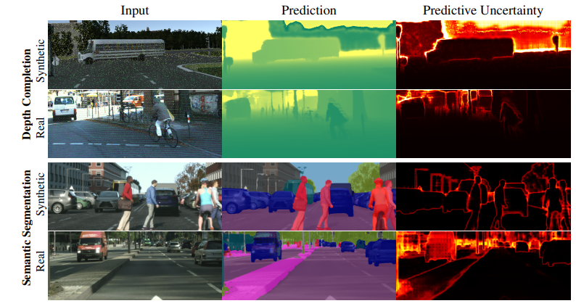
How to evaluate uncertainties ?
Two types :
Aleatoric uncertainty : uncertainties within the dataset.
Epistemic uncertainty : take into account the uncertainty on the model parameters
⇒ Use ensembling/MC Dropout for uncertainty estimation

Slide 3
Summary
1. Evaluating Deep learning uncertainties on toy models
2. Testing the methods with adversarial attacks and class imbalance on MNIST
3. Testing against out of the distribution data with the CamVid dataset

Slide 4
1. Evaluating Deep learning uncertainties on toy models

Slide 5


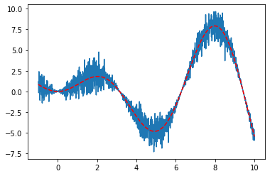
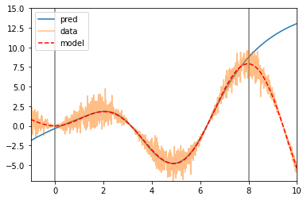
Illustration on toy models
Deterministic NN

Slide 6
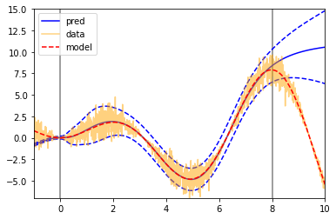

Results with different methods (see notebook)
Simple gaussian NN
SGLD

Slide 7
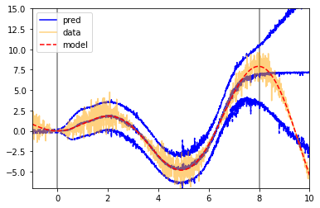
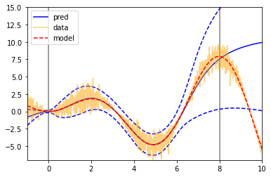
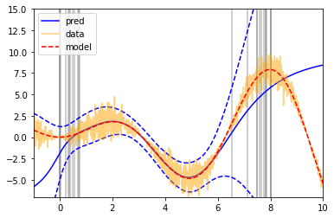
MC Dropout
Ensembling
Bagging along sub-intervals

Slide 8
2. Testing on MNIST

Slide 9
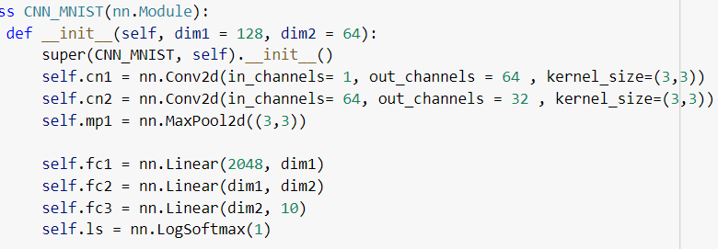
Class imbalance
We created a dataset without 80% of the nines
We used a basic CNN model

Slide 10
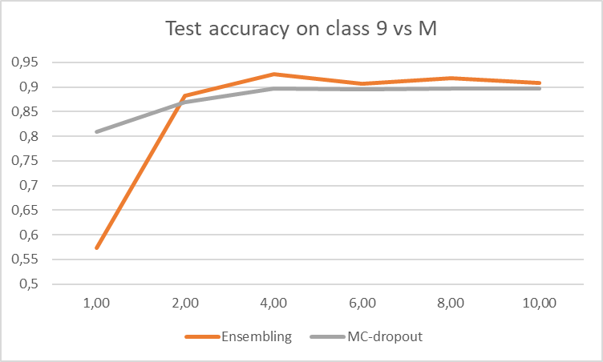

Slide 11
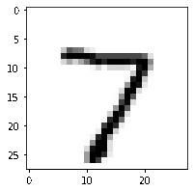
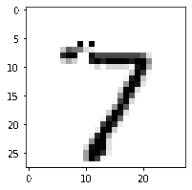
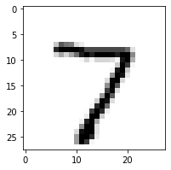
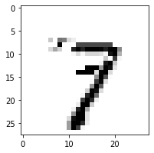
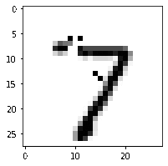
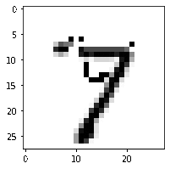
Testing adversarial attacks
To make the attack realistic, we modified only pixels with highest gradient value
Attack on CNN with ensembling
Attack on a basic CNN model:
Model response : 7
Model response : 9
Transforming a 7 into a 9

Slide 12
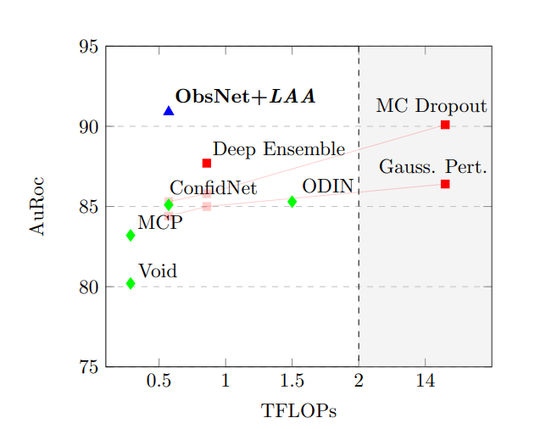
3. Testing against OOD data with the CamVid dataset

Slide 13
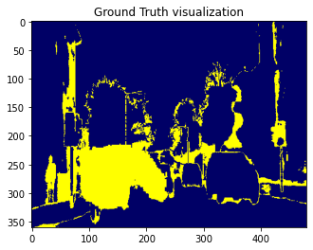
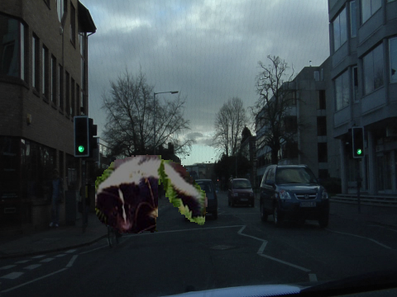
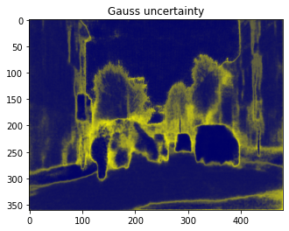
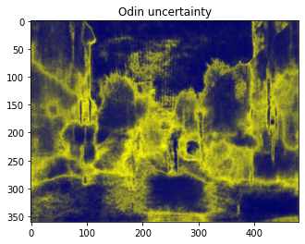
Uncertainties with pretrained SegNet on Out-of-Distribution data

Slide 14
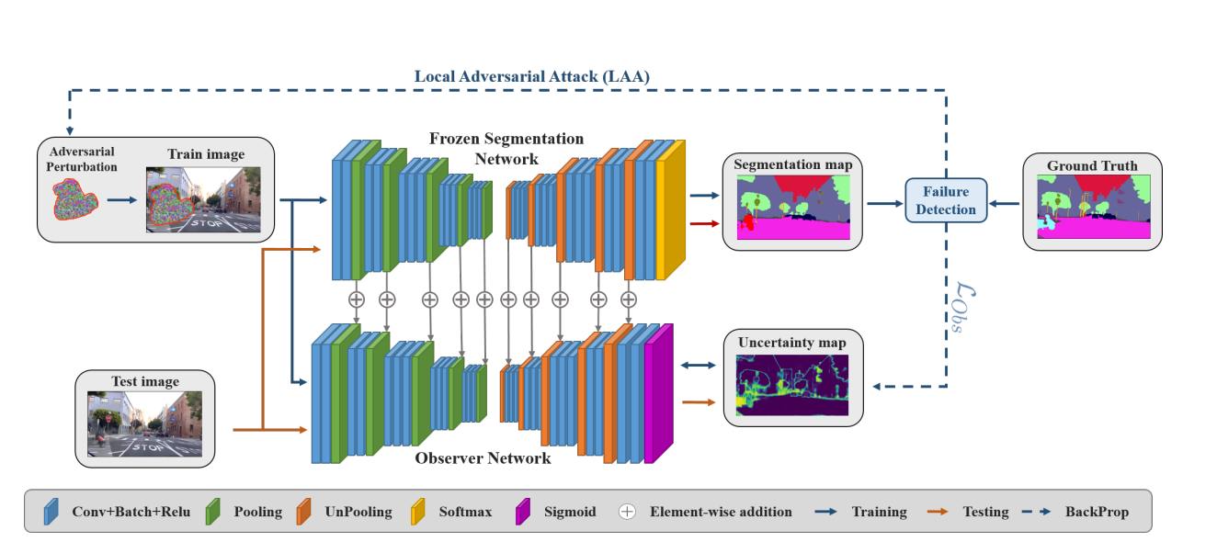
Network structure: entangled SegNet and ObsNet

Slide 15
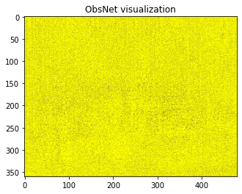
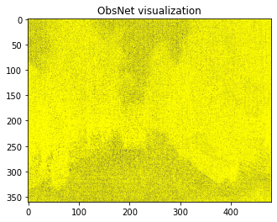
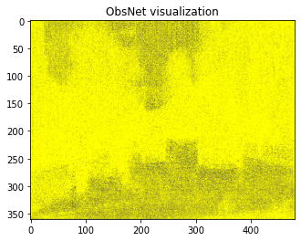
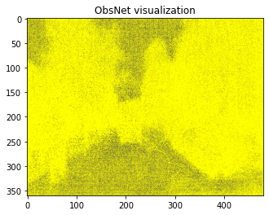

Using ObsNet to detect uncertainties
We used the code provided with the article : Triggering Failures: Out-Of-Distribution detection by learning from local adversarial attacks in Semantic Segmentation (Besnier, Victor and Bursuc, Andrei and Picard, David and Briot Alexandre)
Only 4 training steps on obsnet (with a pretrained segnet)
Original image

Slide 16
Conclusion
Method | Toy model performances | Class imbalance robustness | Adversarial Robustness | Energy and time efficiency
Single NN | - | - | - | ++
Bayesian (MC-Dropout, SGLD) | + | + | ++ | +
Ensemble Method (Random Initialization, Bagging) | ++ | ++ | ++ | –

